Slide 1
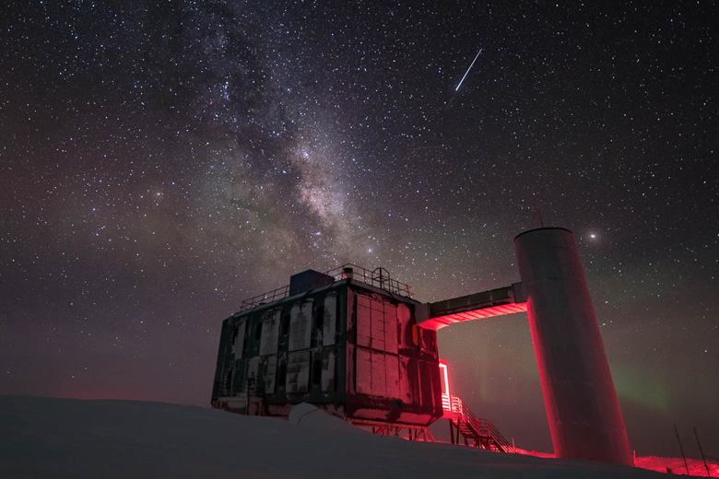
The IceCube Neutrino Observatory: The Perfect Muon Detector Unraveling Cosmic Secrets
Pascal Gutjahr
TU Dortmund University
pascal.gutjahr@tu-dortmund.de
LPC – Clermont-Ferrand
06.10.2023
icecube..wisc.edu

Slide 2
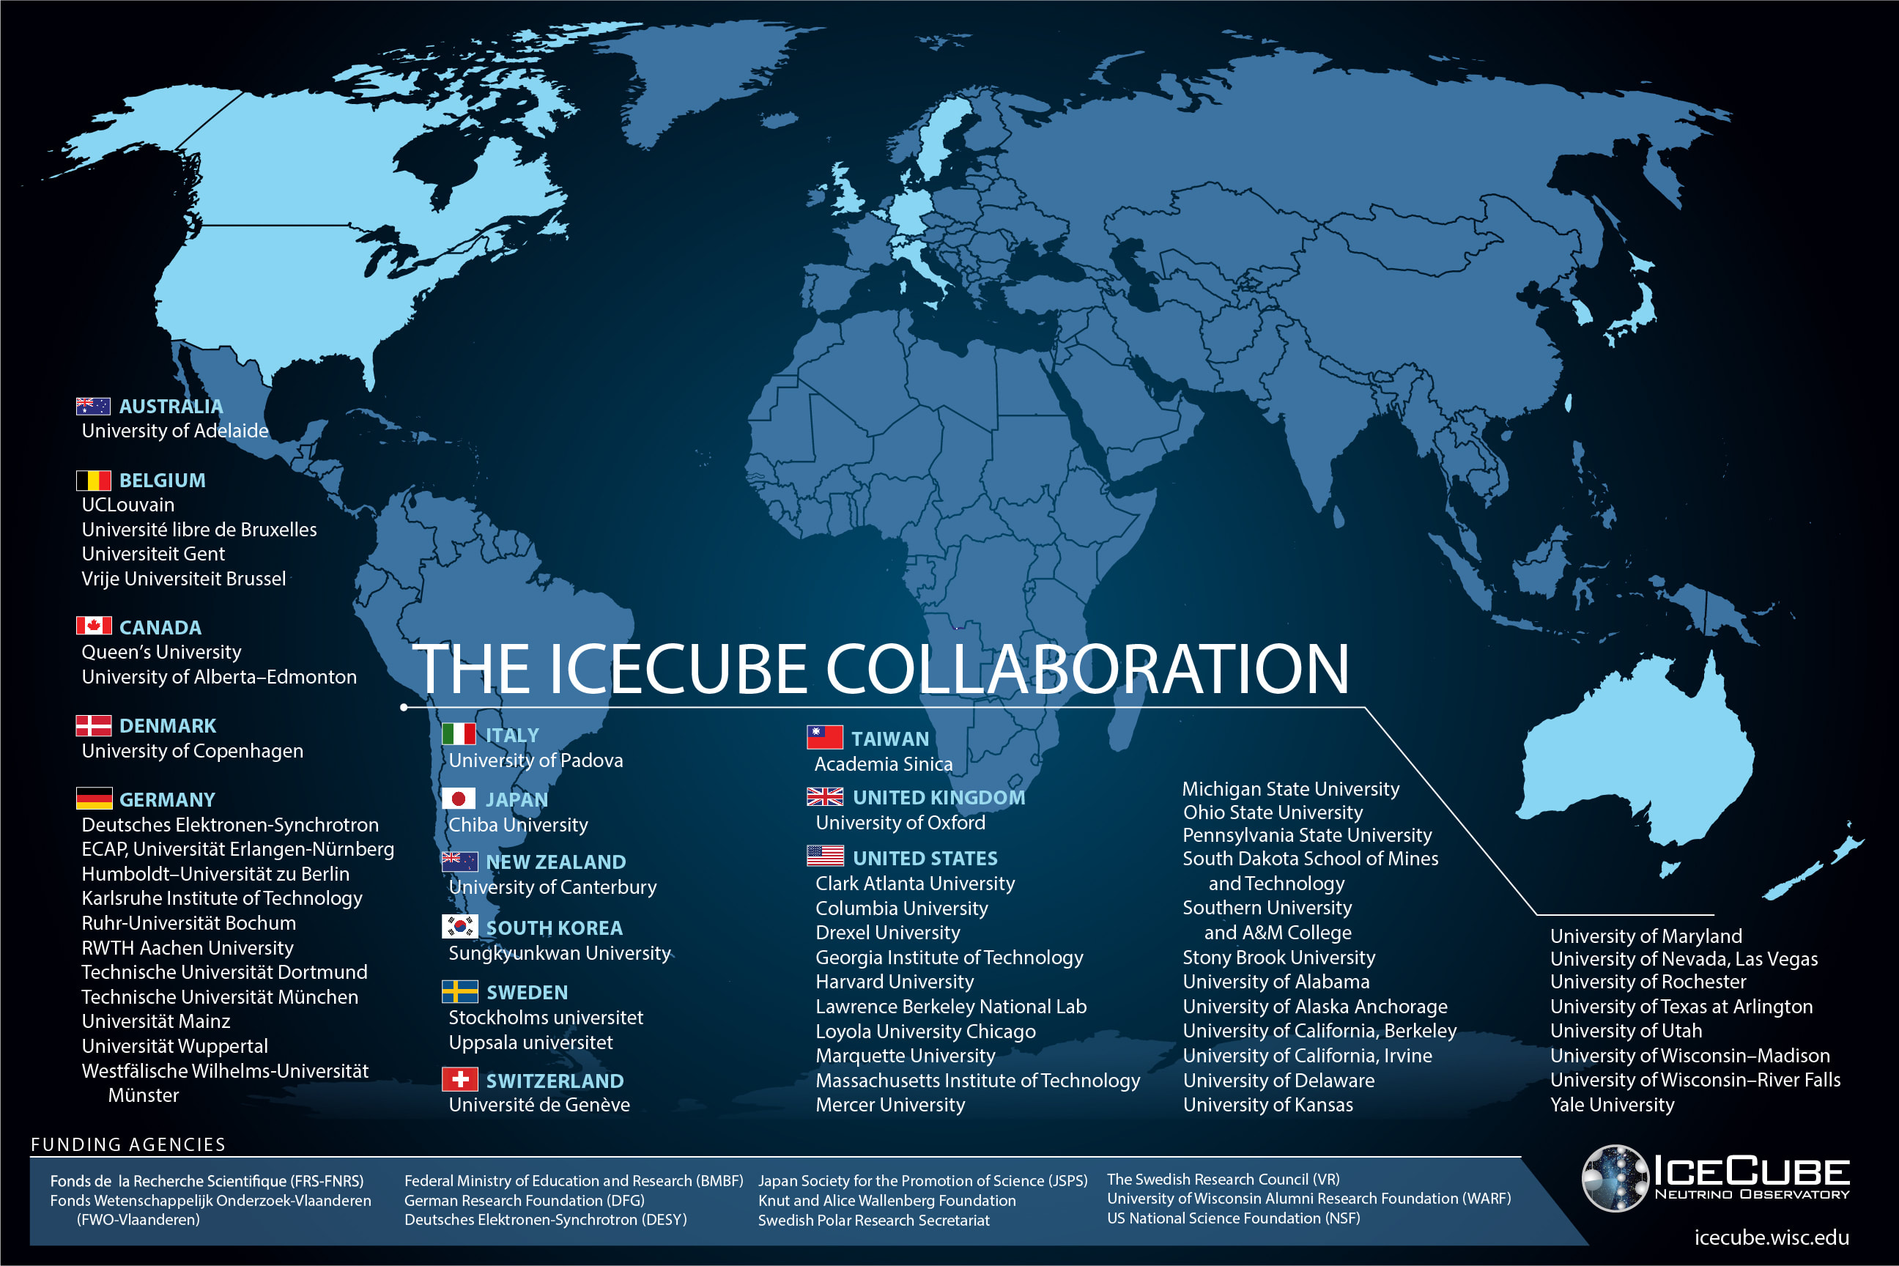

Slide 3
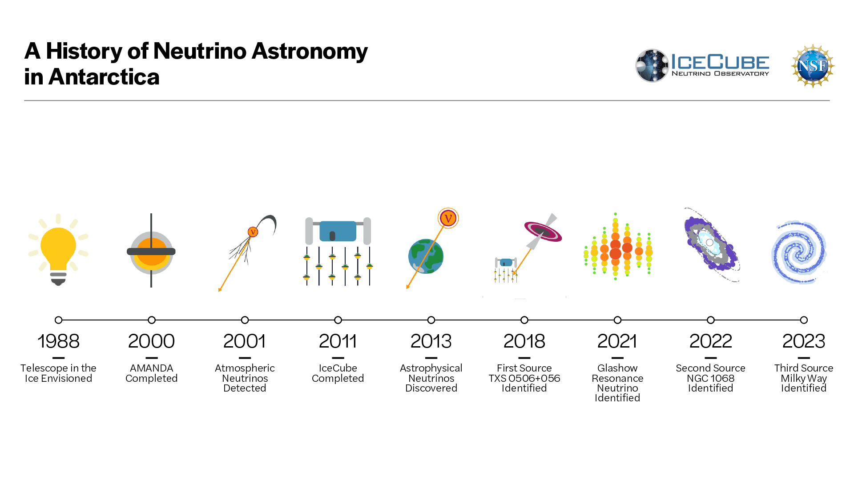
3

Slide 4
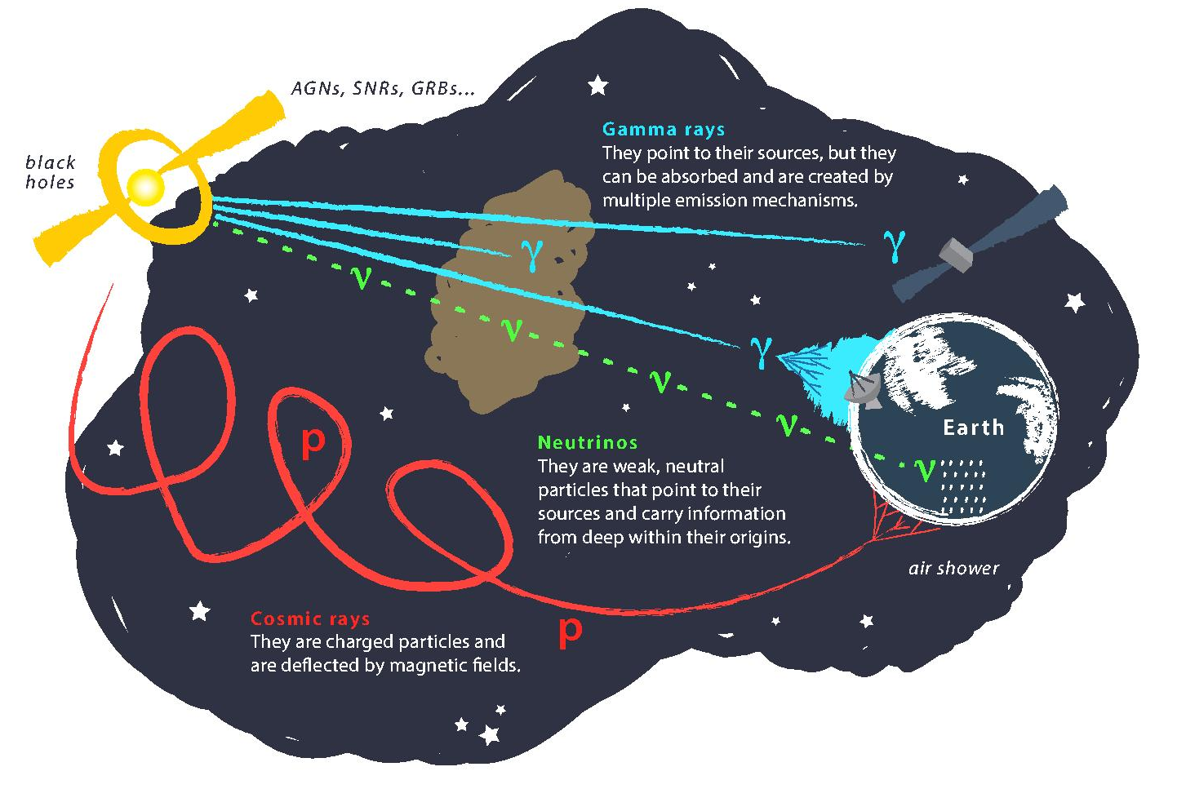
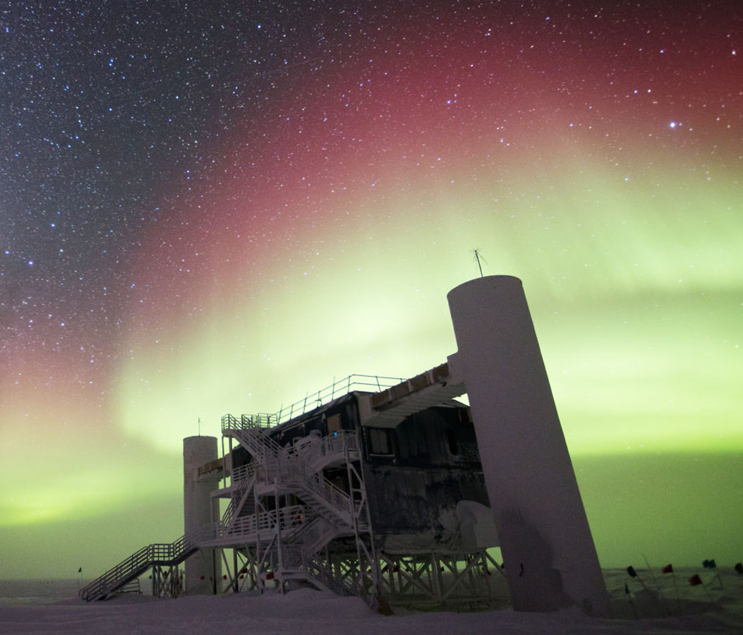
Astroparticle Physics
gallery.icecube.wisc.edu
Credit: IceCube / NSF

Slide 5
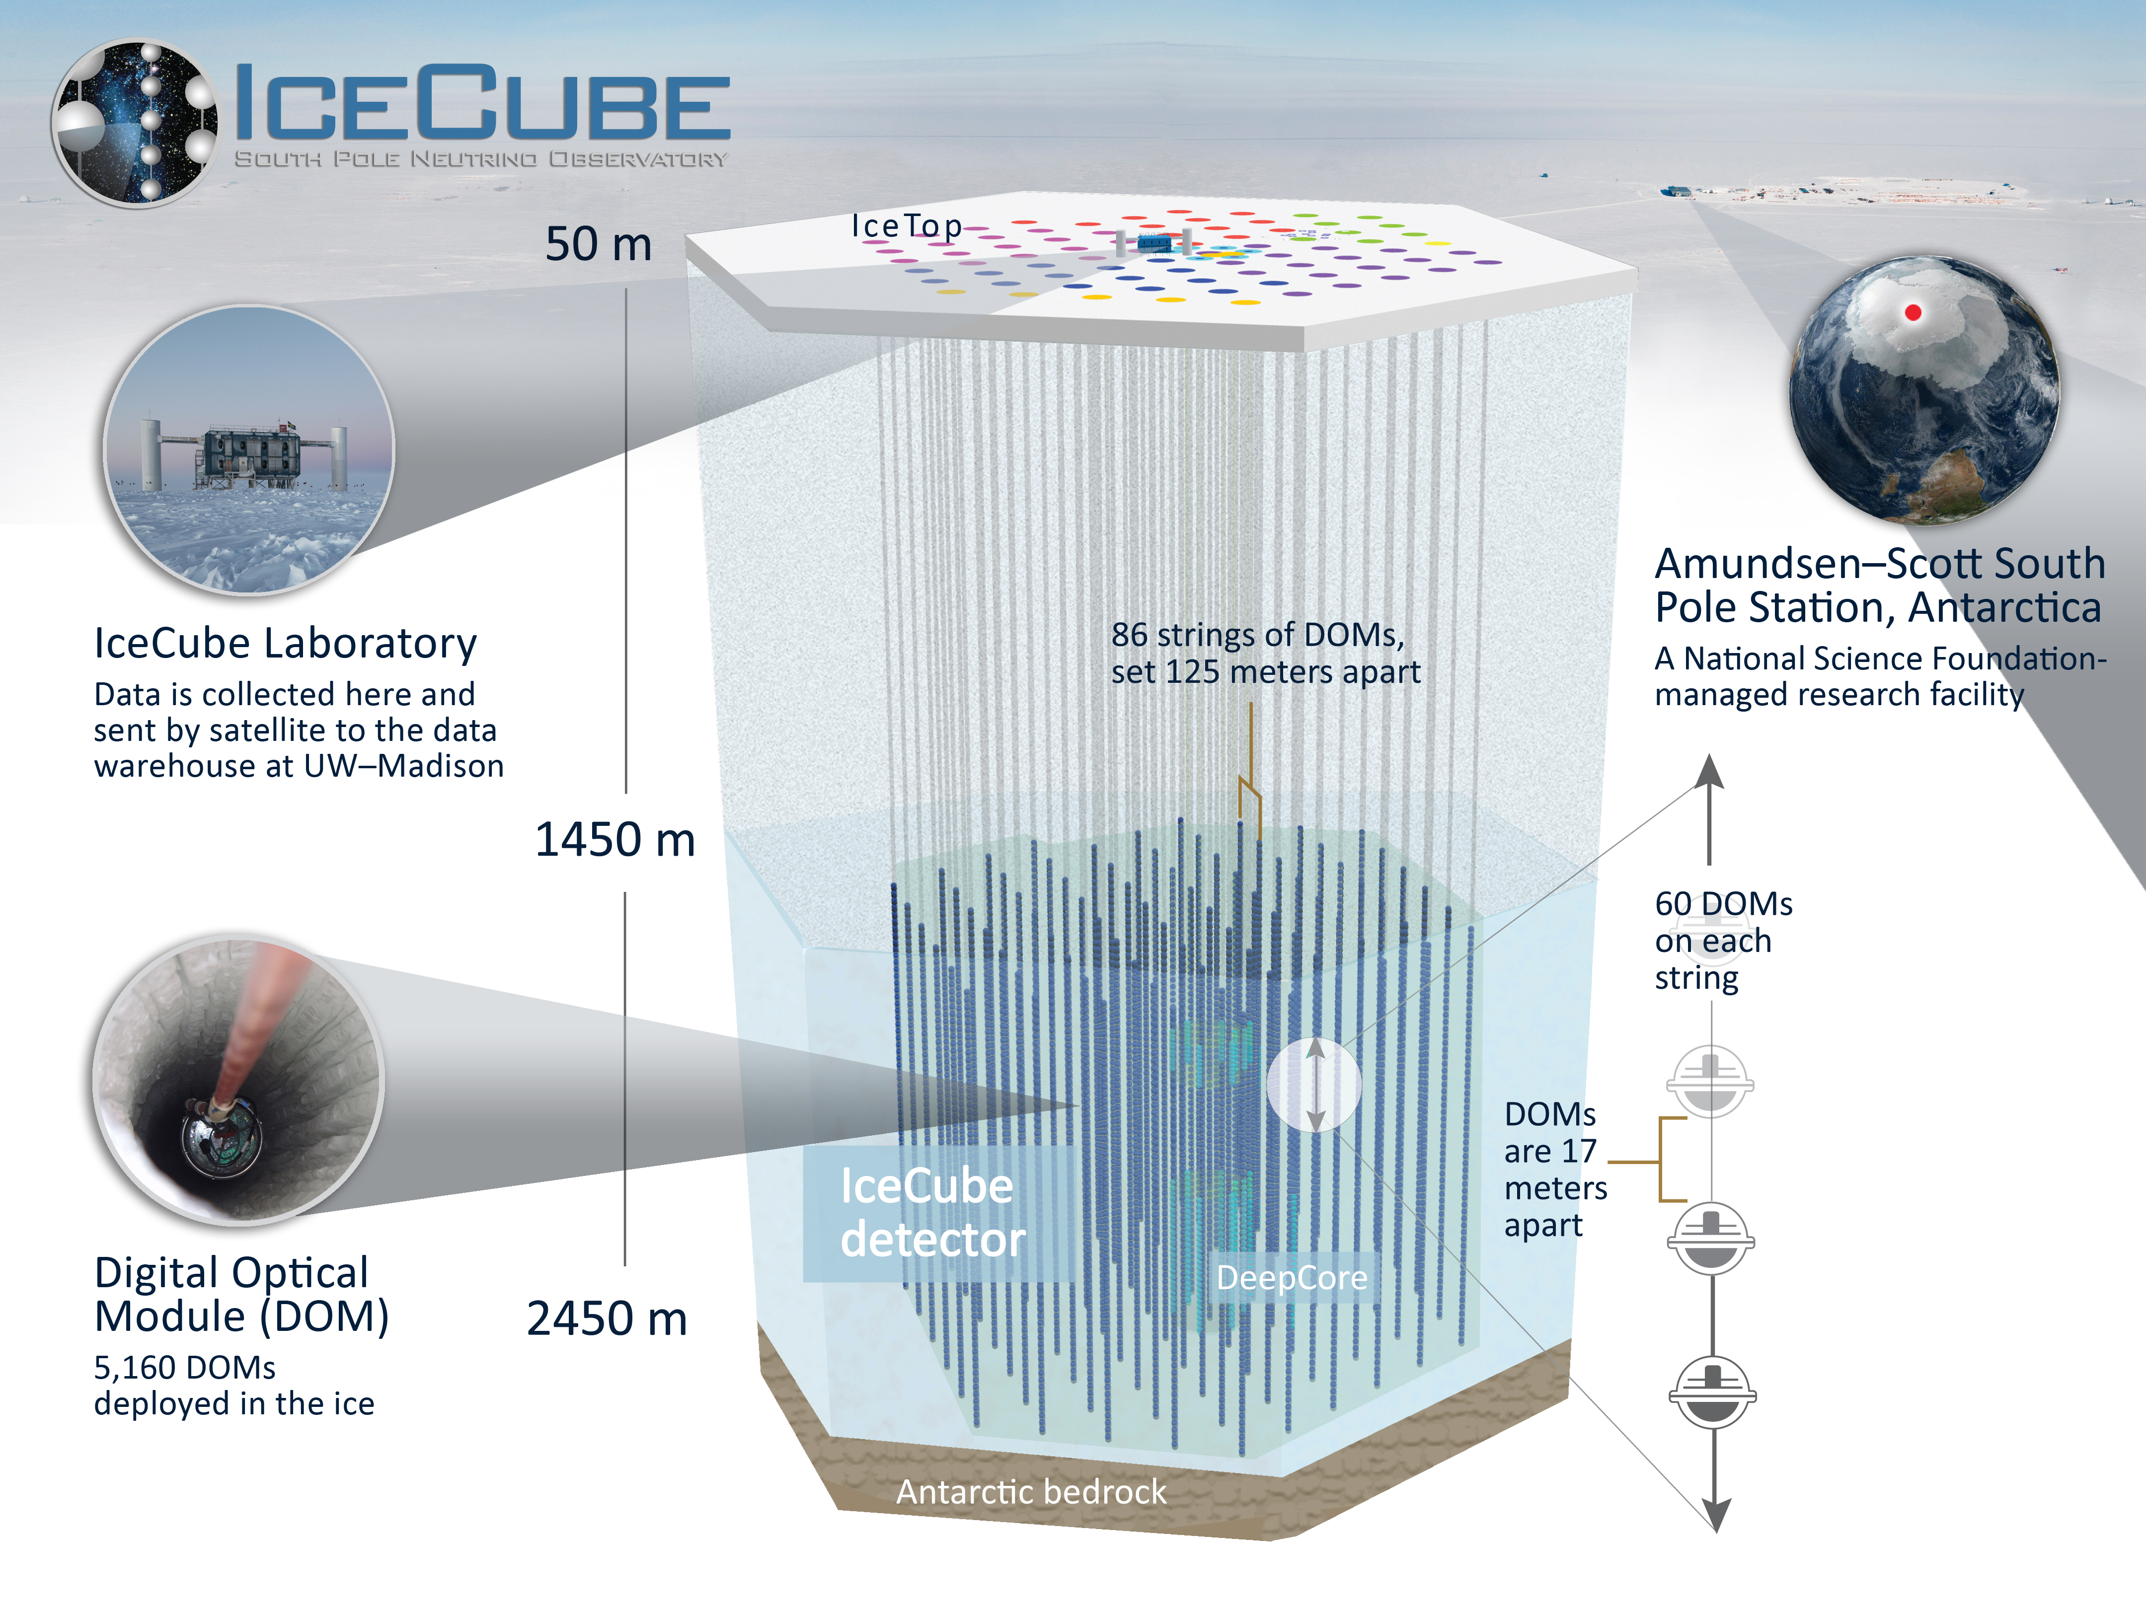
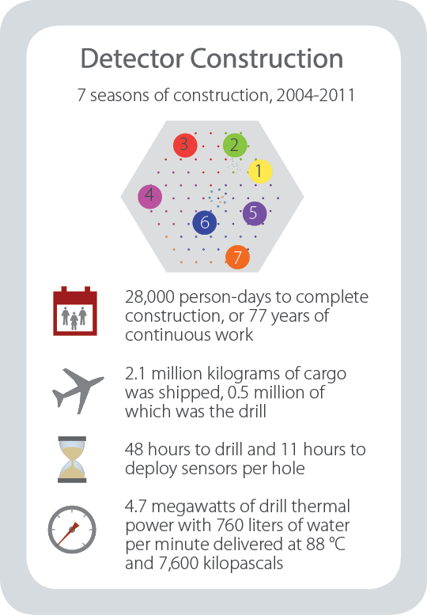
gallery.icecube.wisc.edu

Slide 6
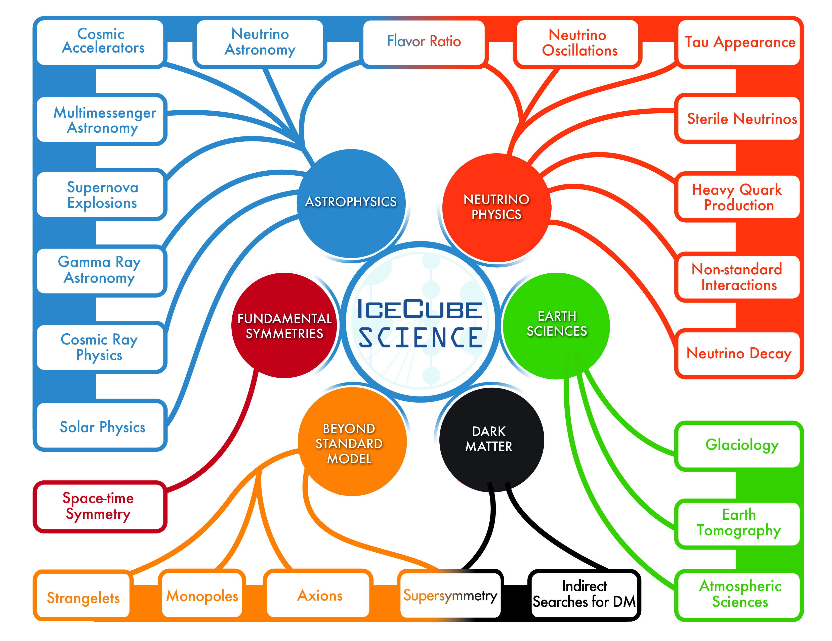
gallery.icecube.wisc.edu

Slide 7
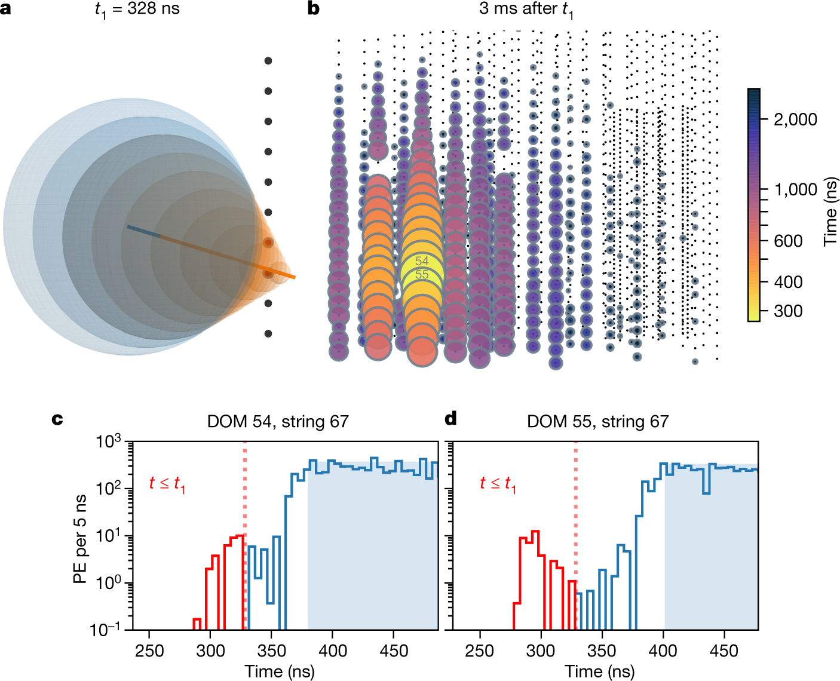
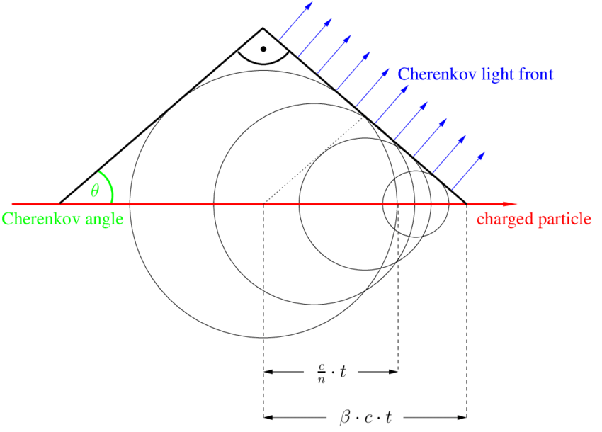
Particle Detection – Cherenkov Light
10.1038/s41586-021-03256-1
T. Gluesenkamp

Slide 8
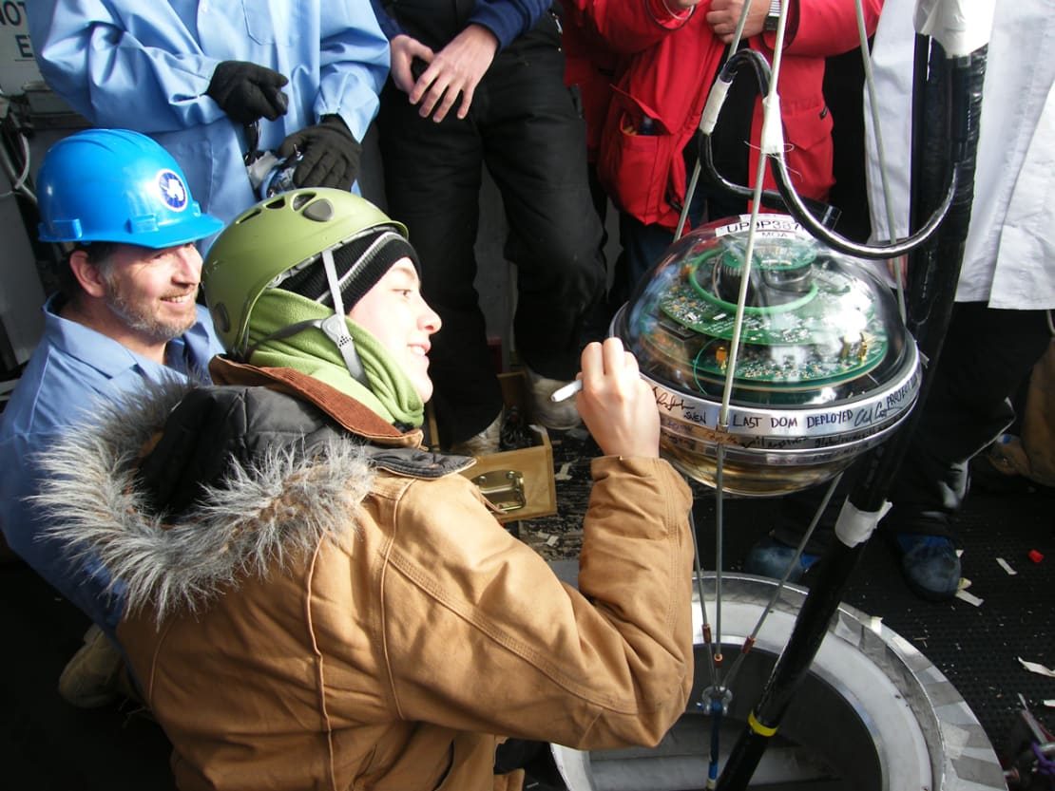
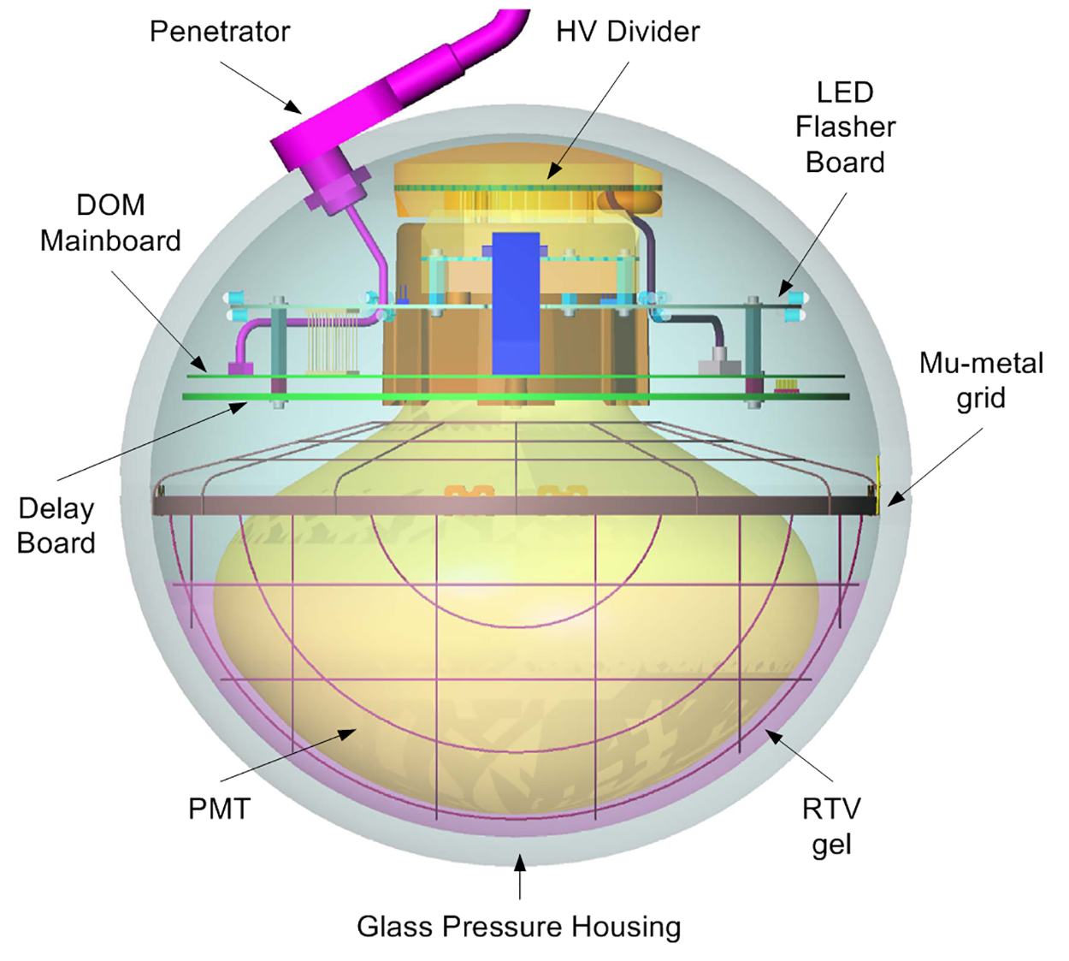
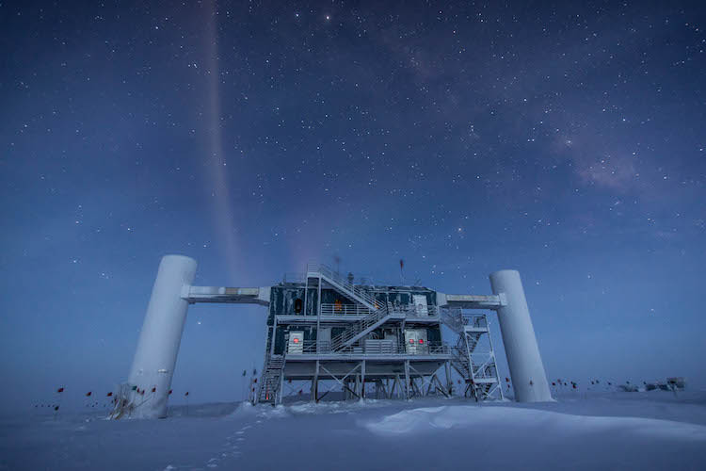
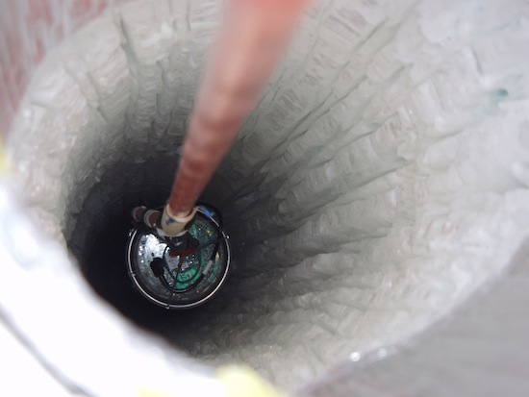
Digital Optical Module (DOM)
icecube.wisc.edu
phys.org
icecube.wisc.edu

Slide 9
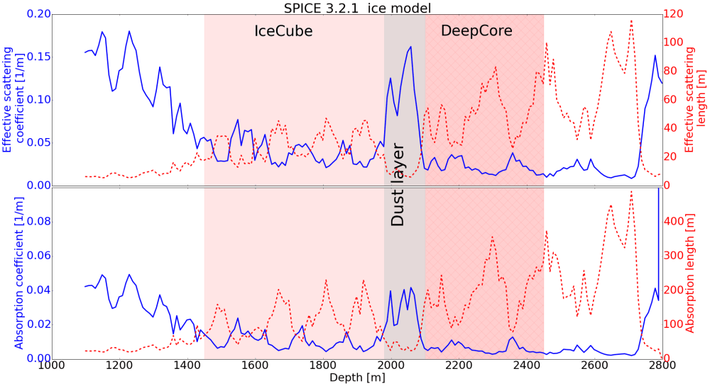
Detection Medium - Ice
icecube..wisc.edu

Slide 10
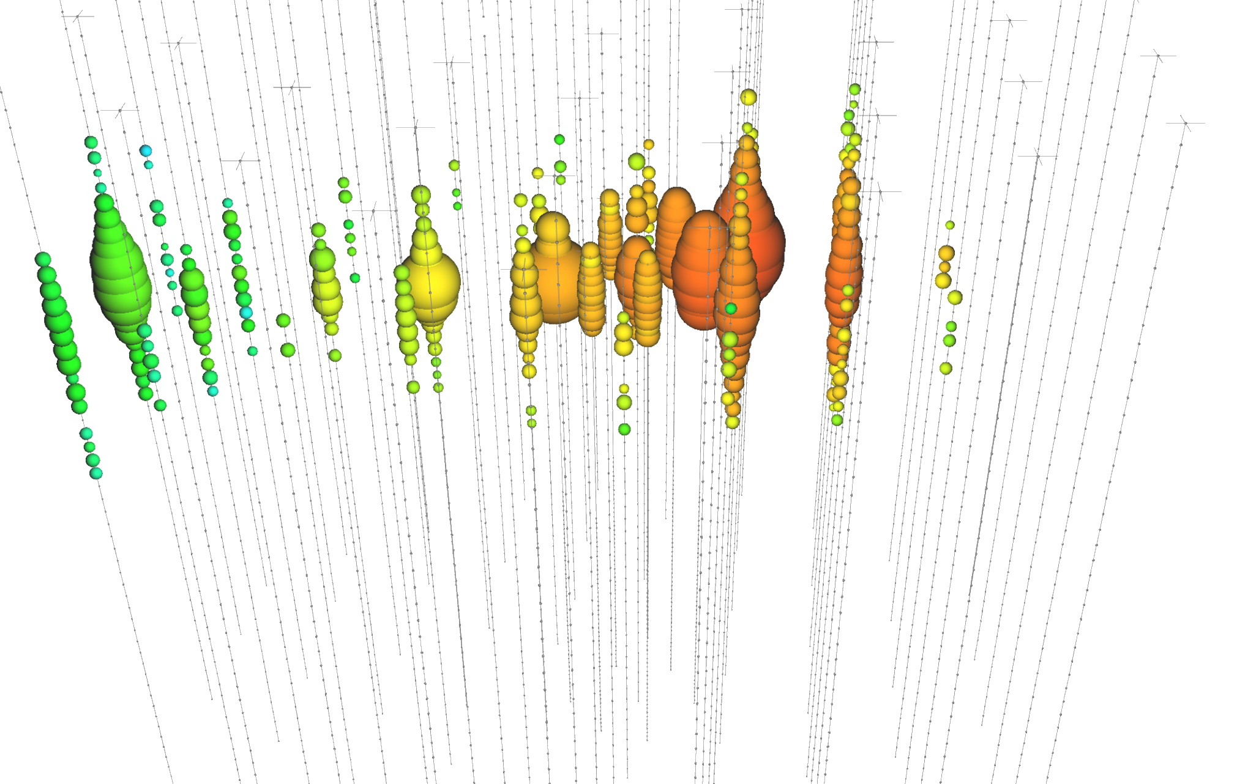
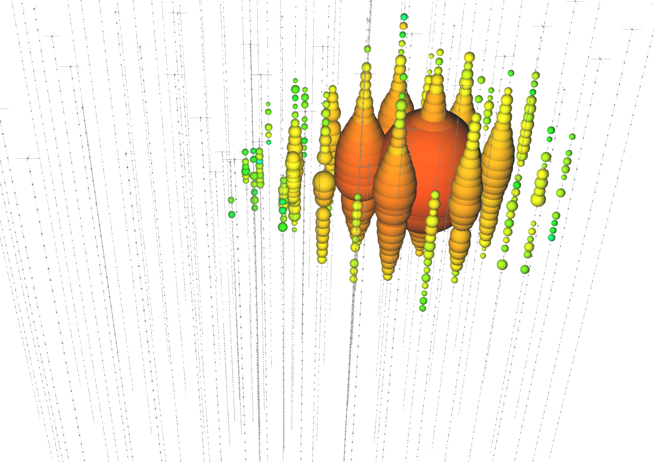
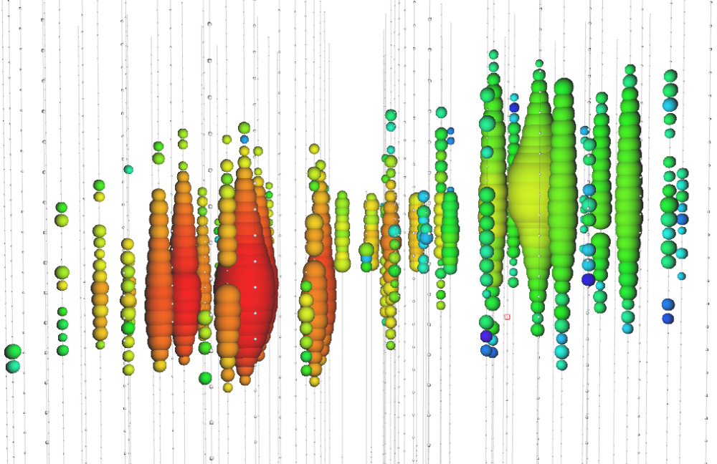
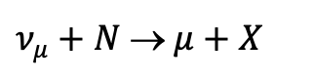
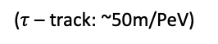
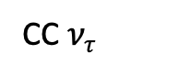
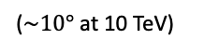
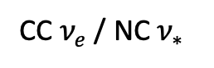
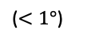
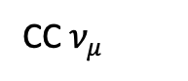
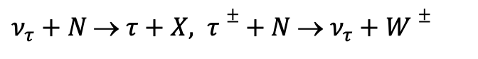
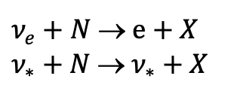
Event Topologies
CC $ν_{μ}$
CC $ν_{e}$ / NC $ν_{∗}$
CC $ν_{τ}$
icecube.wisc.edu
$ν_{μ}+N$ → $μ+X$
$ν_{e}+N$ → $e+X$
$ν_{∗}+N$ → $ν_{∗}+X$
$ν_{τ}+N$ → $τ+X, τ±+ N$ → $ν_{τ}+W±$
Track
Cascade
Cascade / Track / Double-Cascade
($<1°$)
($\sim 10°$ at 10 TeV)
($τ$ – track: ~50m/PeV)

Slide 11
11

Slide 12

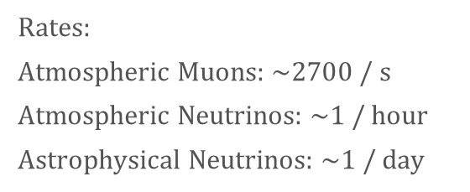
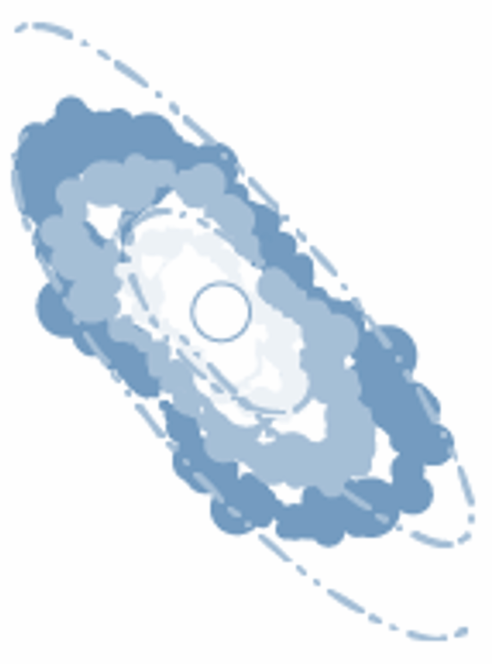
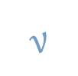
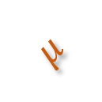
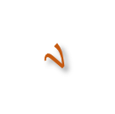
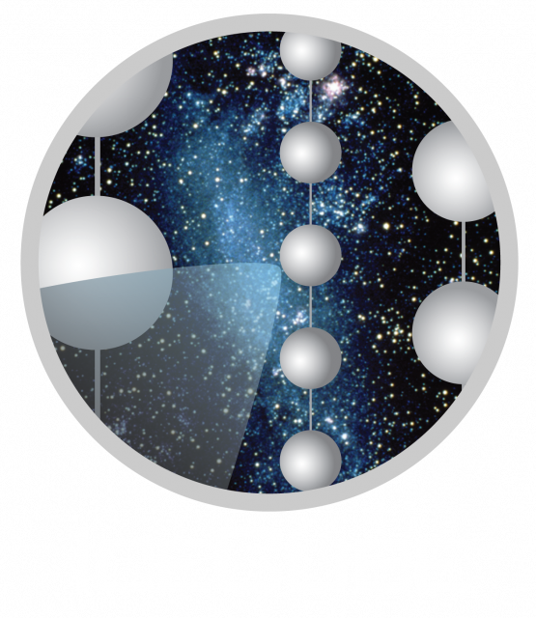
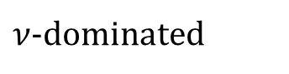
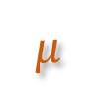
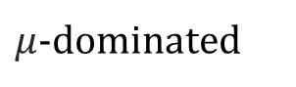
Air Shower
Astrophysical Source
Atmosphere
(not to scale)
Air shower
Air shower

Slide 13
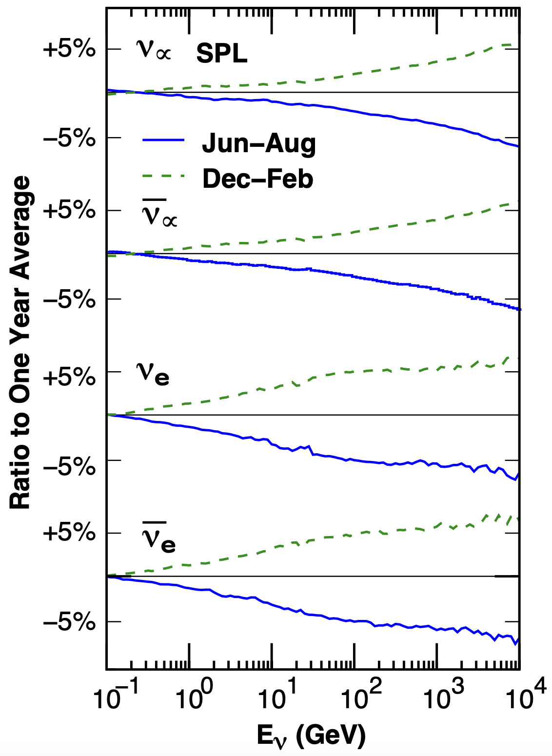
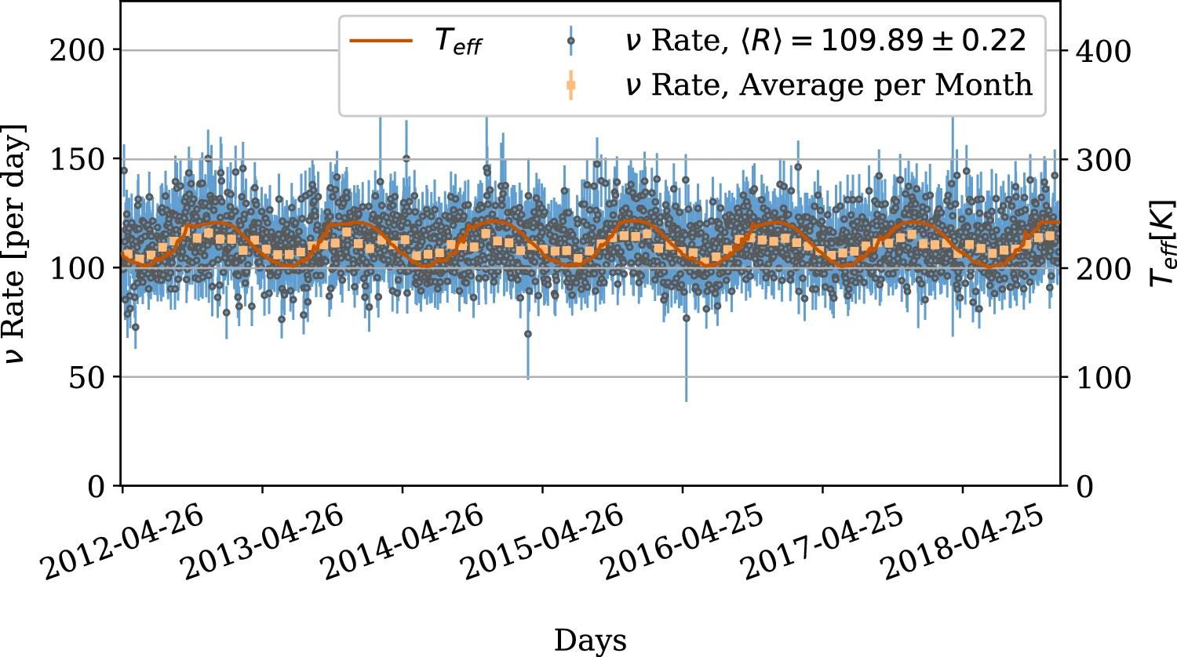
Seasonal Variations of Atmospheric Neutrinos
10.1140/epjc/s10052-023-11679-5
10.1103/PhysRevD.92.023004

Slide 14
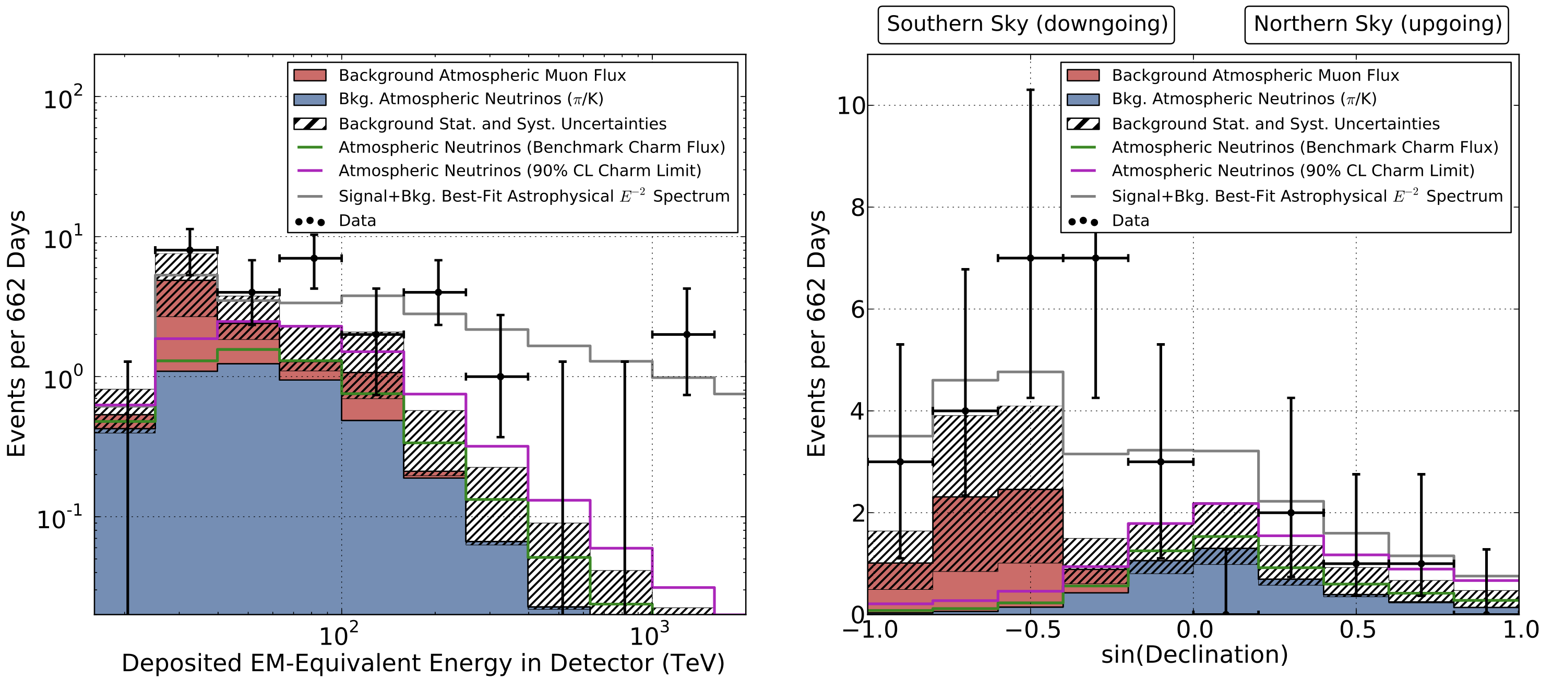
Astrophysical Neutrinos Discovered
10.1126/science.1242856

Slide 15
15

Slide 16
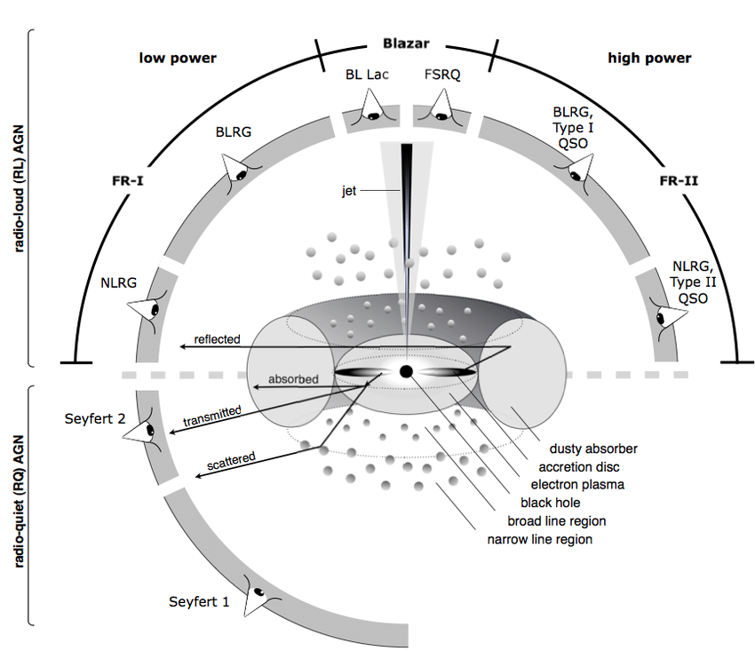
Active Galactic Nucleus (AGN)
Beckmann & Shrader 2012

Slide 17
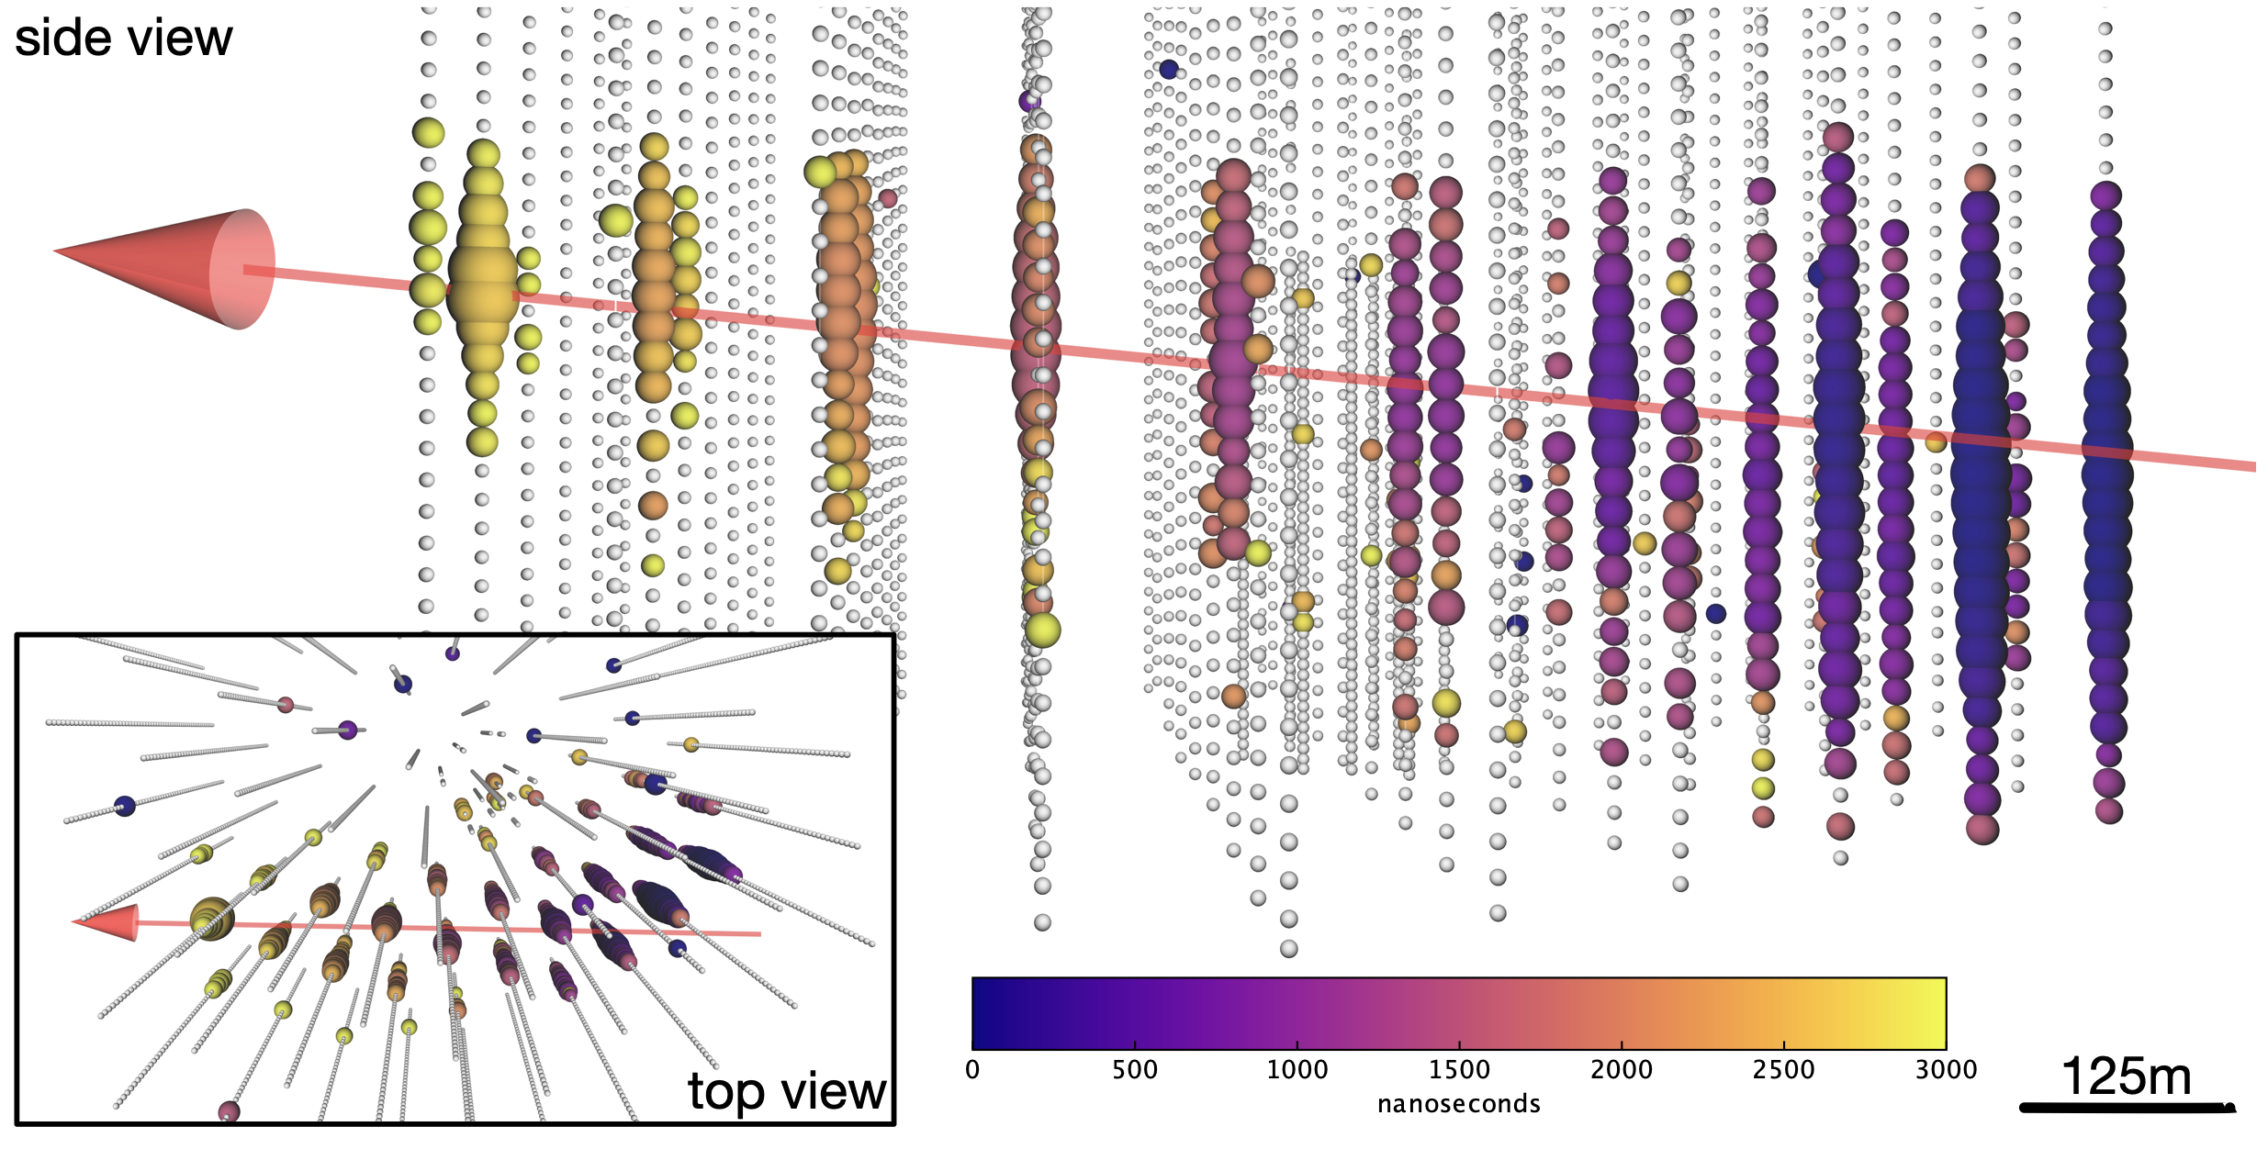
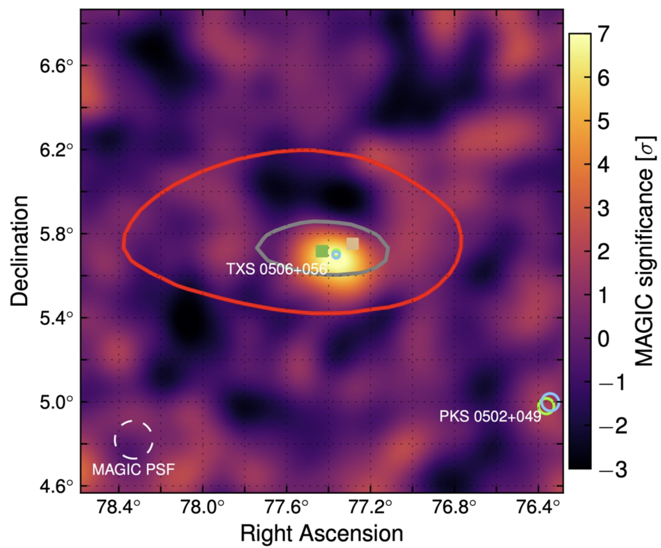
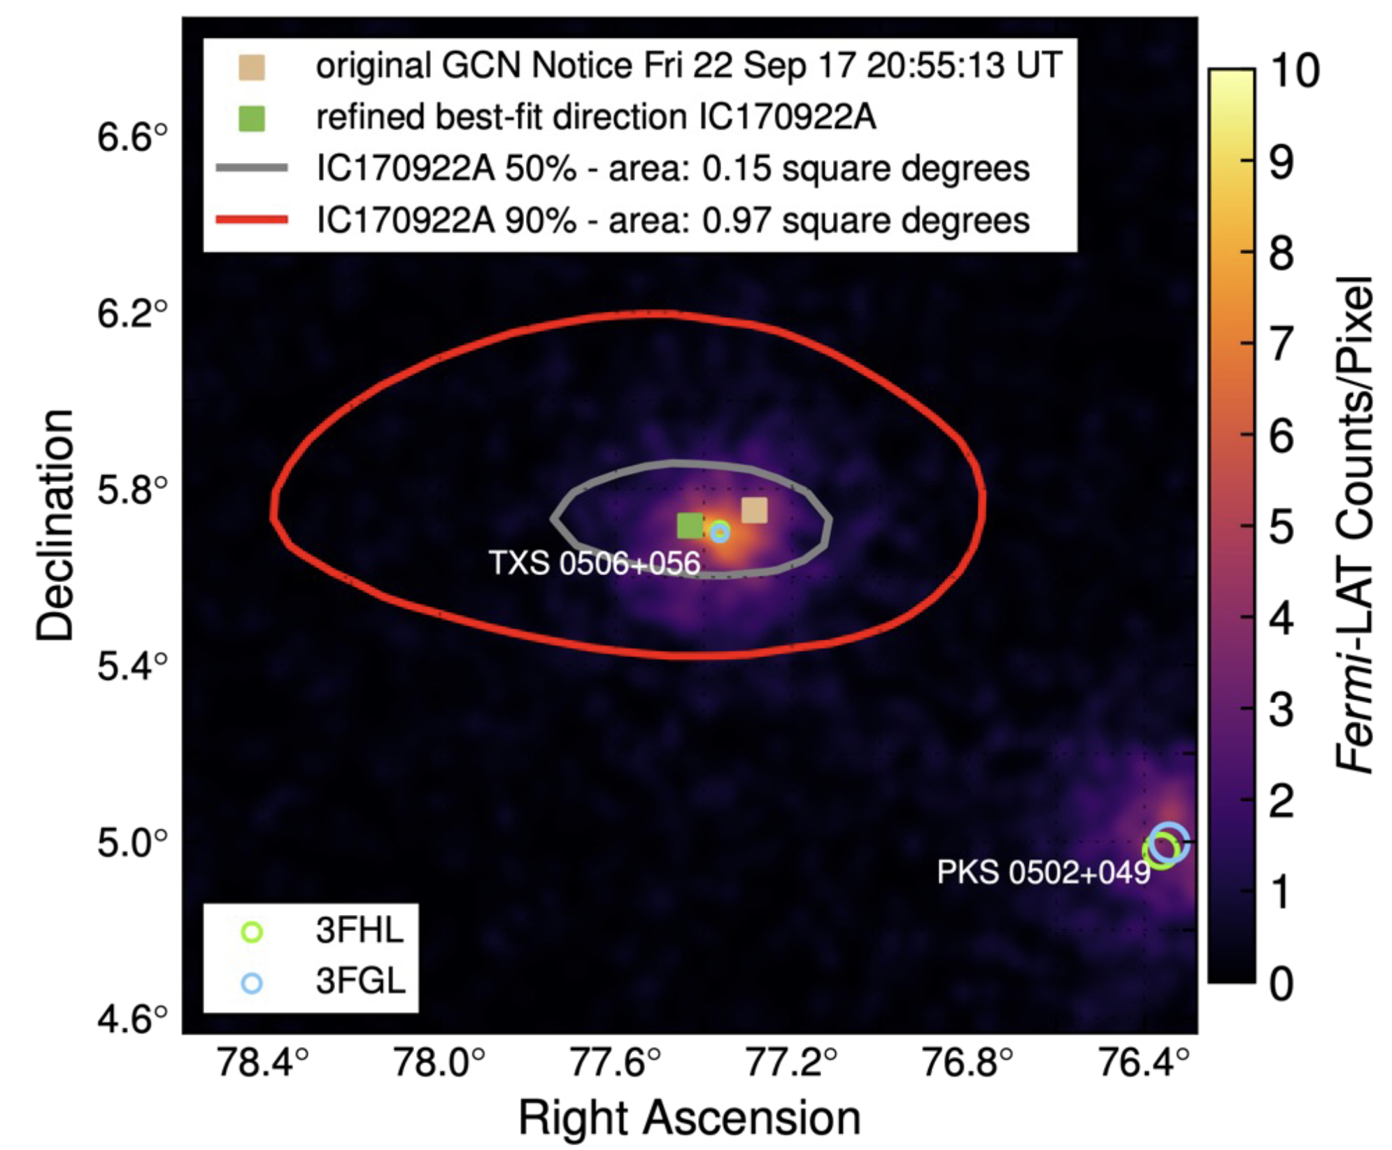
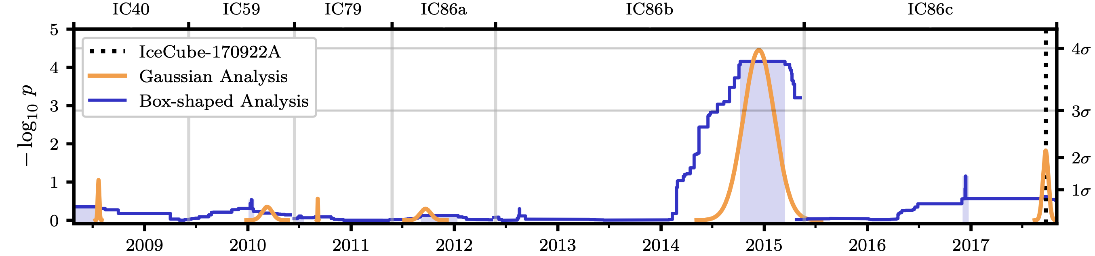
First Source TXS 0506+056 Identified
10.1126/science.aat1378
10.1126/science.aat1378
10.1126/science.aat2890

Slide 18
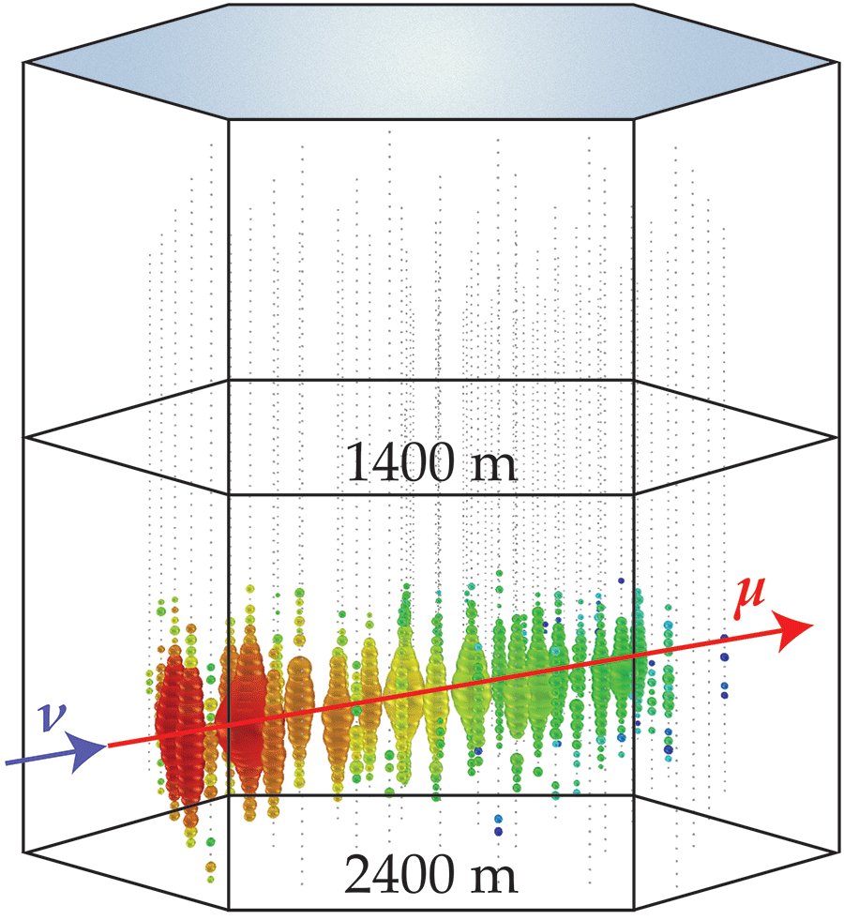
Muon Deflection – Motivation
Illustration: APS/Joan Tycko
10.22323/1.444.1197

Slide 19
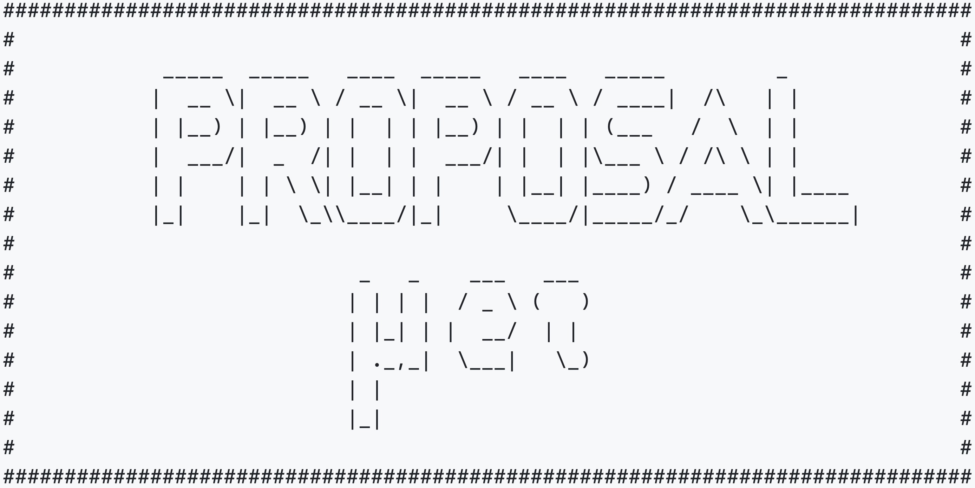
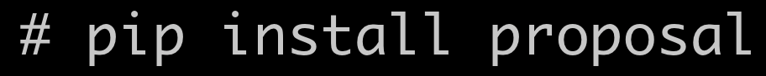
Muon Deflection – Simulation
PRopagator with Optimal Precision and Optimal Speed for All Leptons
Used in:
IceCube
KM3NeT
NOvA
NuRadioMC
CORSIKA 8
TAMBO
Baikal-GVD
P-One
type
d
E_{i}
E_{f}
medium
developed and mainted in Dortmund
github.com/tudo-astroparticlephysics/PROPOSAL

Slide 20
Muon Deflection – Results
10.22323/1.444.1197
10.1140/epjc/s10052-022-11102-5

Slide 21
Muon Deflection – Data/MC
7.3 GeV, 1.44 cm copper
199 MeV, 1.09 cm liquid H₂
10.22323/1.444.1197

Slide 22
22

Slide 23
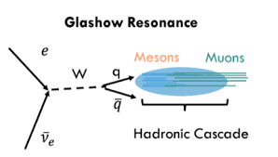
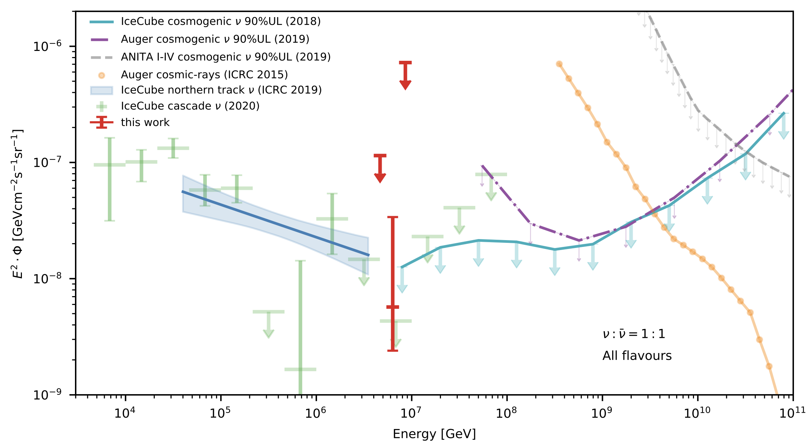
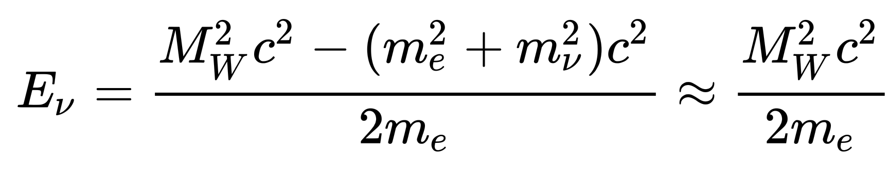


Glashow Resonance Neutrino Identified
10.1038/s41586-021-03256-1
6.3 PeV

Slide 24
24

Slide 25


Second Source NGC 1068 Identified
10.1126/science.abg3395

Slide 26
26

Slide 27

Multiwavelength Milky Way

Slide 28



Third Source Milky Way Identified
After trial-correction: $4.5σ$
Model | Signal Events | Pre-trial p-value ($Nσ$)
$$π^{0}$$ | 748 | $$1.26×{10}^{−6} (4.71σ)$$
$${KRA}_{γ}^{5}$$ | 276 | $$6.13×{10}^{−6} (4.37σ)$$
$${KRA}_{γ}^{50}$$ | 211 | $$3.72×{10}^{−5} (3.96σ)$$
$π^{0}$: based on Fermi-LAT gamma-ray measurements (DOI: 10.1088/0004-637X/750/1/3)
${KRA}_{γ}^{5/50}$: based on Gaggero et. al (DOI 10.1088/2041-8205/815/2/L25)
10.1126/science.adc9818

Slide 29
Multiwavelength Multimessenger Milky Way
neutrinos

Slide 30
The Muon Puzzle

Slide 31

Cosmic Ray Flux
1903.07713

Slide 32


The Muon Puzzle
”muon number”
2108.08341

Slide 33

The Muon Puzzle
Expected z
2108.08341

Slide 34




Air Shower Profiles – 10 TeV
zeuthen.desy.de
Ralph Engel 2005
2211.16970v2
Proton
Iron

Slide 35

Possible Solutions
Hans Dembinski

Slide 36






Connection to LHC
Hans Dembinski
10.1103/PhysRevD.83.054026

Slide 37

Atmospheric Prompt Muons and Neutrinos
10.1103/PhysRevD.100.103018

Slide 38
The Future of IceCube

Slide 39


IceCube Upgrade
nbi.ku.dk
icecube.wisc.edu

Slide 40




IceCube Gen-2
icecube.wisc.edu

Slide 41



Radio Neutrino Astronomy
Radio:
larger attenuation length
covers bigger volume
detect higher energies
Askaryan effect -> similar to Cherenkov effect -> charge anisotropy -> emission of radio radiation -> particle energy scales with frequency
2010.12279
10.3847/1538-4357/ac4d29

Slide 42
Conclusion

Slide 43
Backup

Slide 44

Possible Solutions
number of secondary particles
fraction of most energetic particle
energy ratio carried by photons
from short-lived hadrons
inelastic hadronic cross-section
10.1007/s10509-022-04054-5

